Slide 2
Generative Models
How do we generate images?
What I cannot create, I do not understand

Slide 3
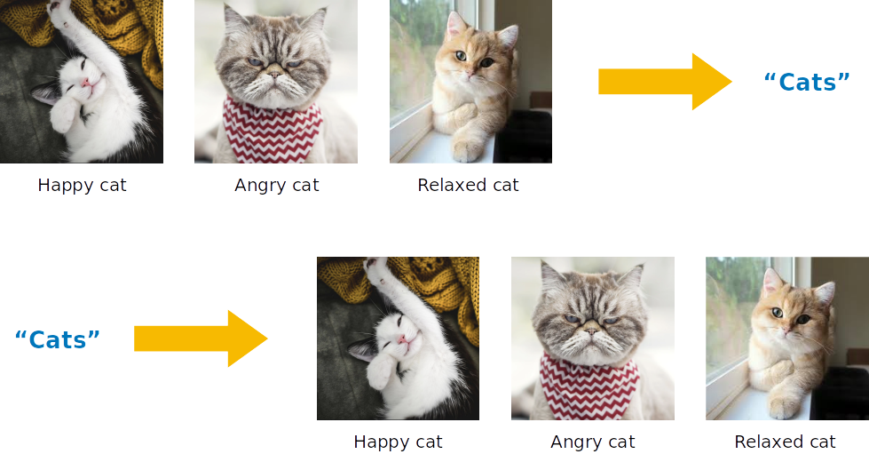
Generative Models
Classification: mapping a distribution to a certain output
Generation: mapping a distribution to a certain output

Slide 4
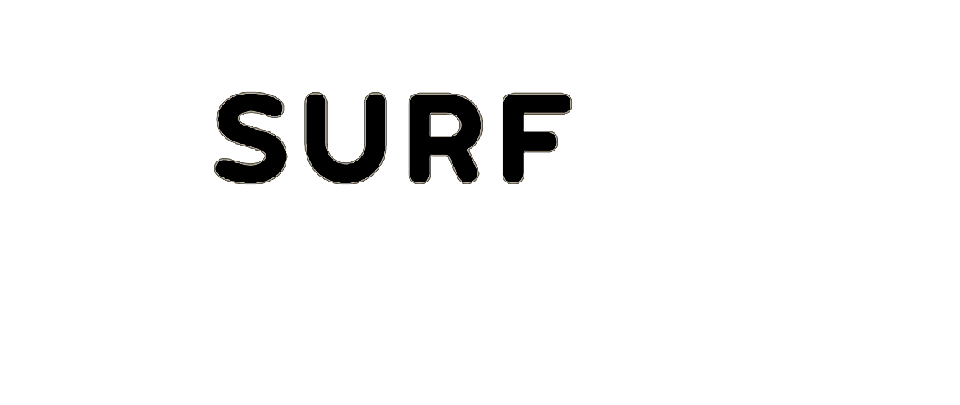
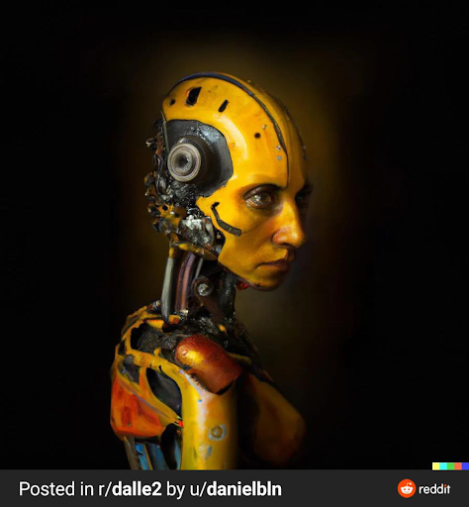


DALL-E
“A yellow futuristic organic robot by Boston Dynamics”
OpenAI

Slide 5
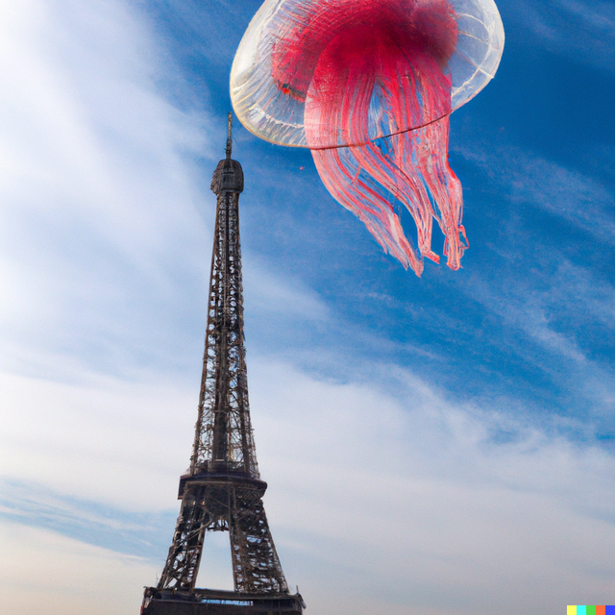
DALL-E
“A giant jellyfish floating above the eiffel tower”
OpenAI

Slide 6
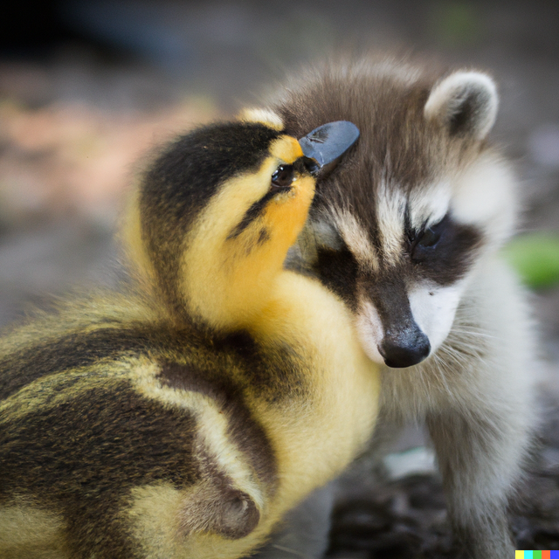
DALL-E
“A cute baby raccoon hugging a cute baby duckling”

Slide 7
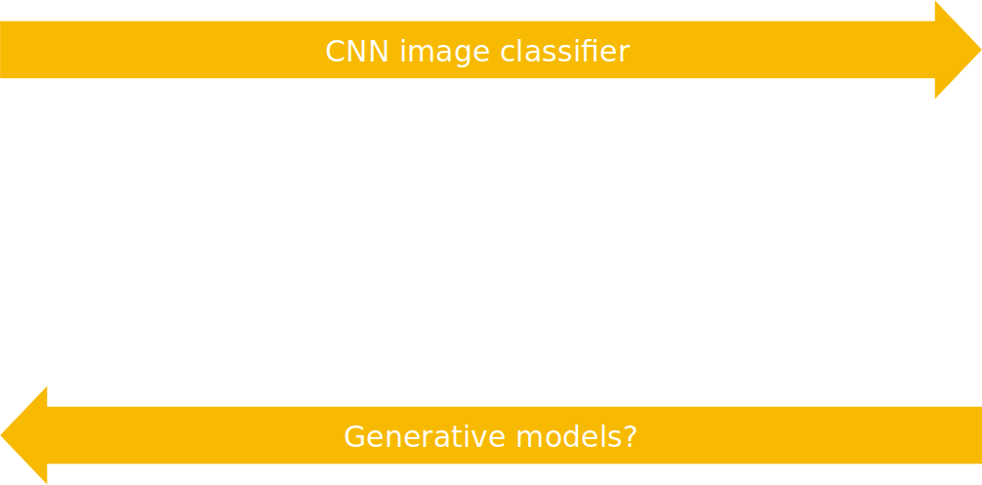

Generative Models

Slide 8
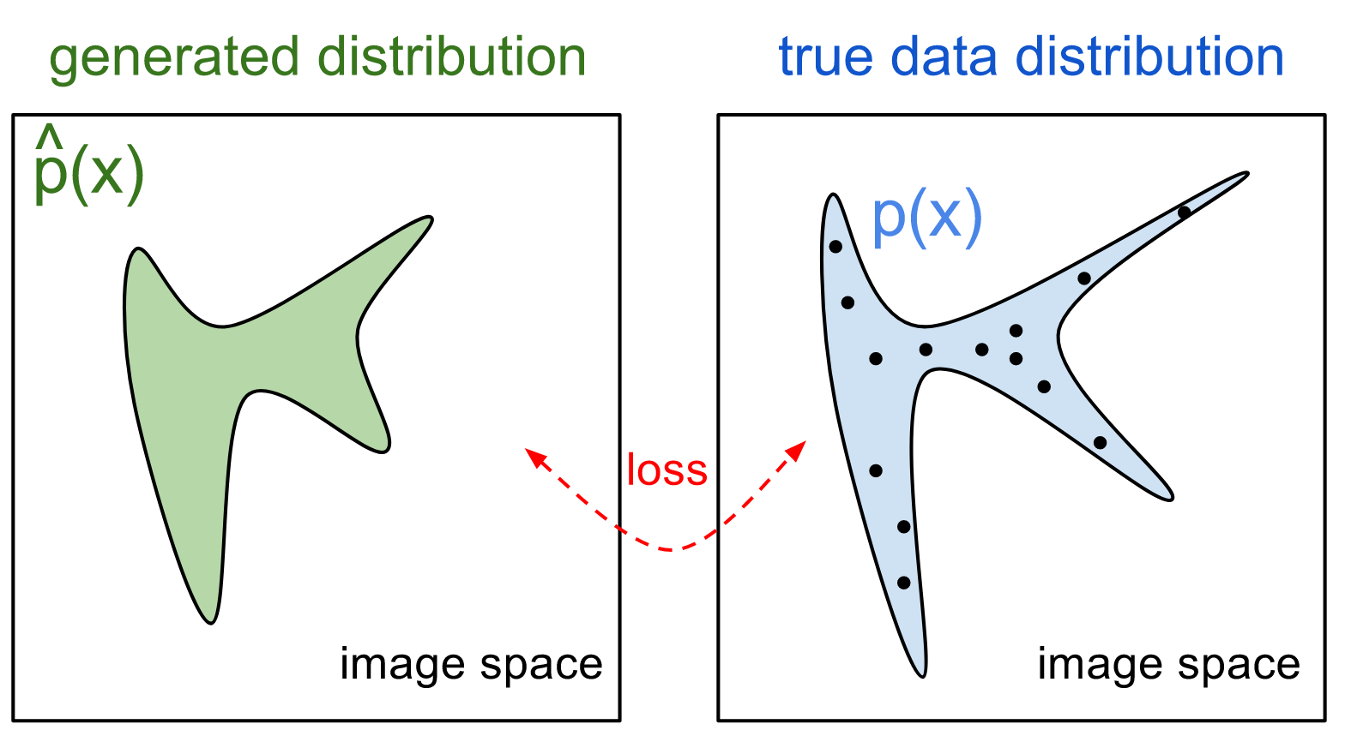
Generative Models

Slide 9
Generative Models

Slide 10
Generative Models
A generative model
Learns the data distribution instead
Allows uncertainties to be captures
Allows for (condition) density estimation

Slide 11
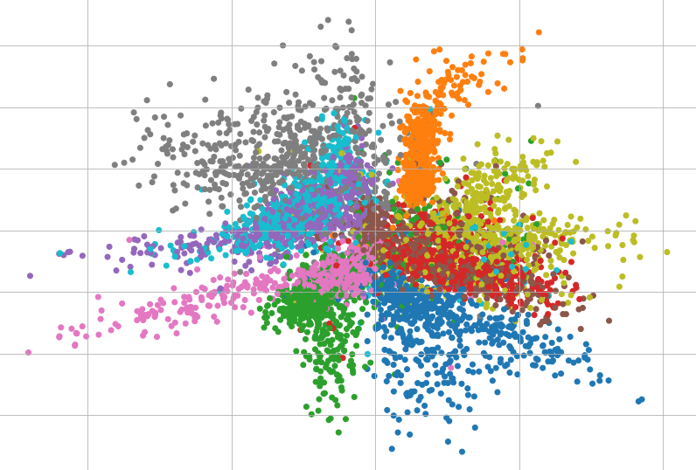
AutoEncoder
How data is represented is imperative for neural networks
The data representation could have been engineered by a human

Slide 12
AutoEncoder
How data is represented is imperative for neural networks
The data representation could have been engineered by a human
As an alternative: Feed raw data to the neural network and learn the representation automatically

Slide 13
AutoEncoder
How data is represented is imperative for neural networks
The data representation could have been engineered by a human
As an alternative: Feed raw data to the neural network and learn the representation automatically
Manifold Hypothesis: High-dimensional data “lives” in a lower dimensional manifold
High-dimensional data can be sufficiently represented using lower dimensional latents

Slide 14
AutoEncoder
How data is represented is imperative for neural networks
The data representation could have been engineered by a human
As an alternative: Feed raw data to the neural network and learn the representation automatically
Manifold Hypothesis: High-dimensional data “lives” in a lower dimensional manifold
High-dimensional data can be sufficiently represented using lower dimensional latents
lower dimensional manifold = lower dimensional Latent Space

Slide 15
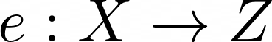
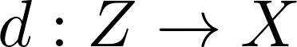
AutoEncoder
Encoder learns a mapping
Decoder learns a mapping

Slide 16
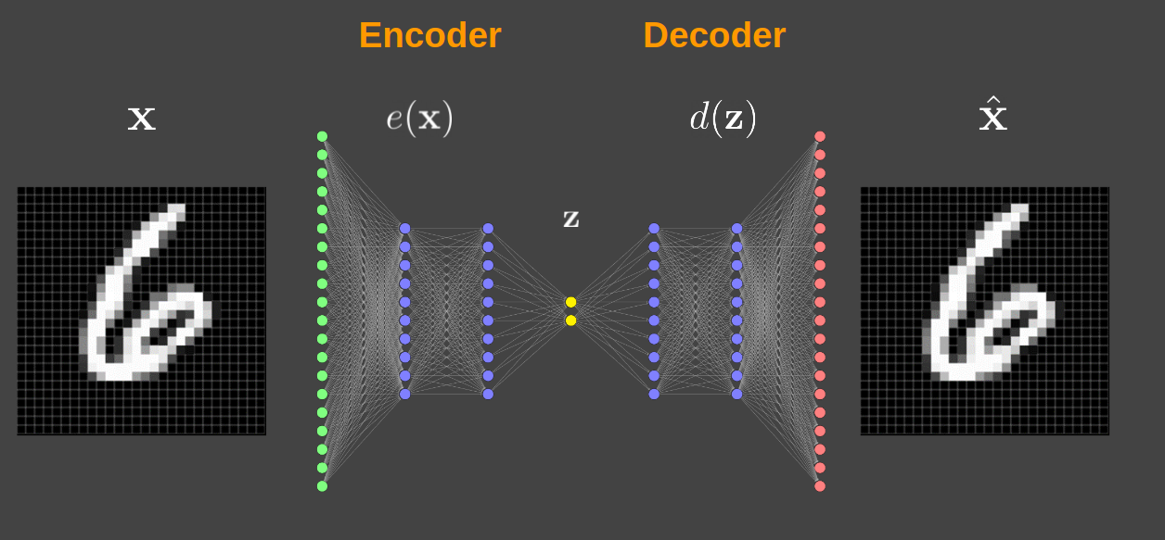
AutoEncoder
Encoder learns a mapping
Decoder learns a mapping

Slide 17
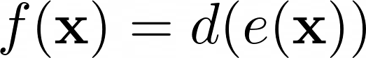
AutoEncoder
Encoder learns a mapping
Nested functions
Decoder learns a mapping

Slide 18
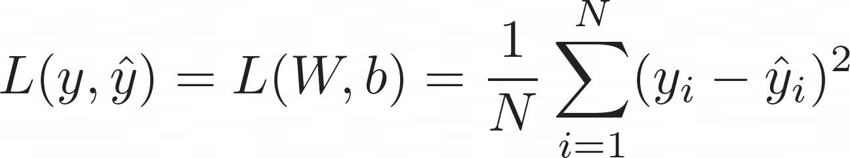
AutoEncoder
Classification

Slide 19
AutoEncoder
Classification

Slide 20
AutoEncoder
Classification

Slide 21
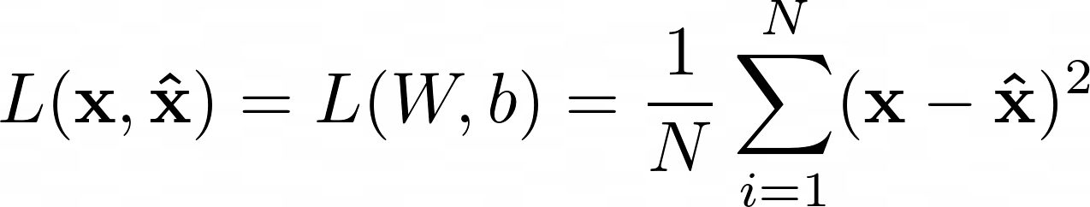
AutoEncoder
Reconstruction Loss

Slide 22
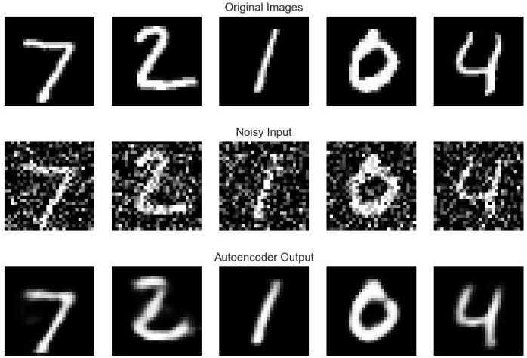
AutoEncoder

Slide 23
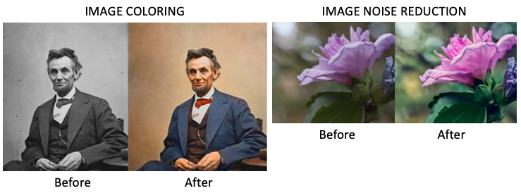
AutoEncoder

Slide 24
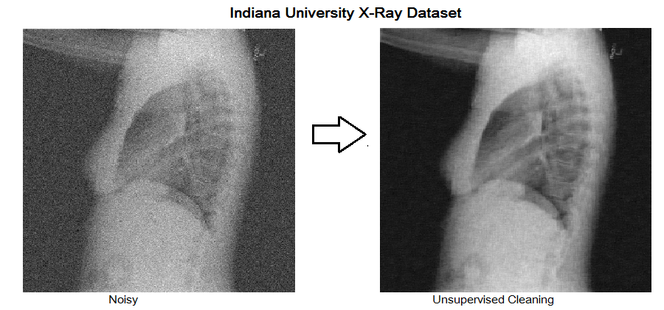
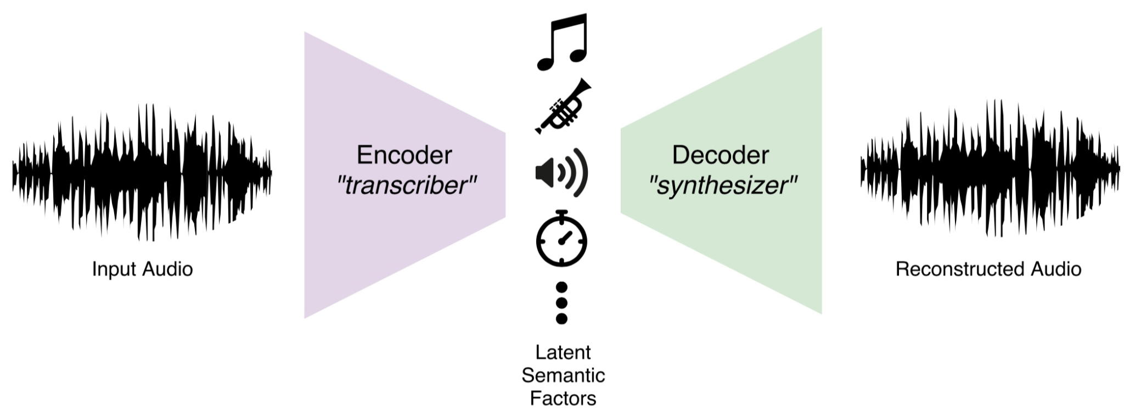
AutoEncoder

Slide 25
AutoEncoder
Issues
Limited use aside from denoising and simple transformations
We cannot generate new data from the learned representations
Suppose we learn a two dimensional representation for MNIST

Slide 26
AutoEncoder
Issues
Limited use aside from denoising and simple transformations
We cannot generate new data from the learned representations
Suppose we learn a two dimensional representation for MNIST

Slide 27
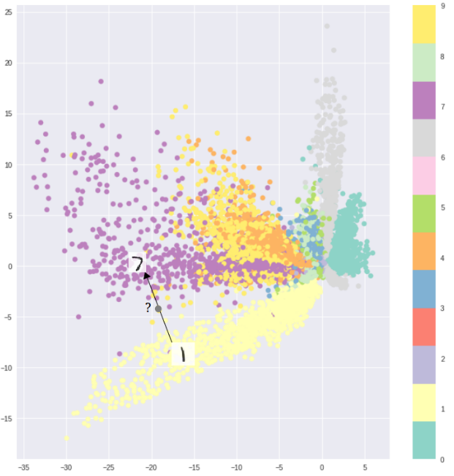
AutoEncoder
Issues
Limited use aside from denoising and simple transformations
We cannot generate new data from the learned representations
Suppose we learn a two dimensional representation for MNIST

Slide 28
AutoEncoder
Issues
Latent space has ‘gaps’
We would like to generate variations of the data from a
gapless/continuous latent space
Keep disentanglement of the features that represent the data

Slide 29
Variational AutoEncoder
Same structure as a normal AutoEncoder
We want stochasticity in our model
Map inputs to a probability distribution over our latent space
Learn the statistics of our latent space

Slide 30
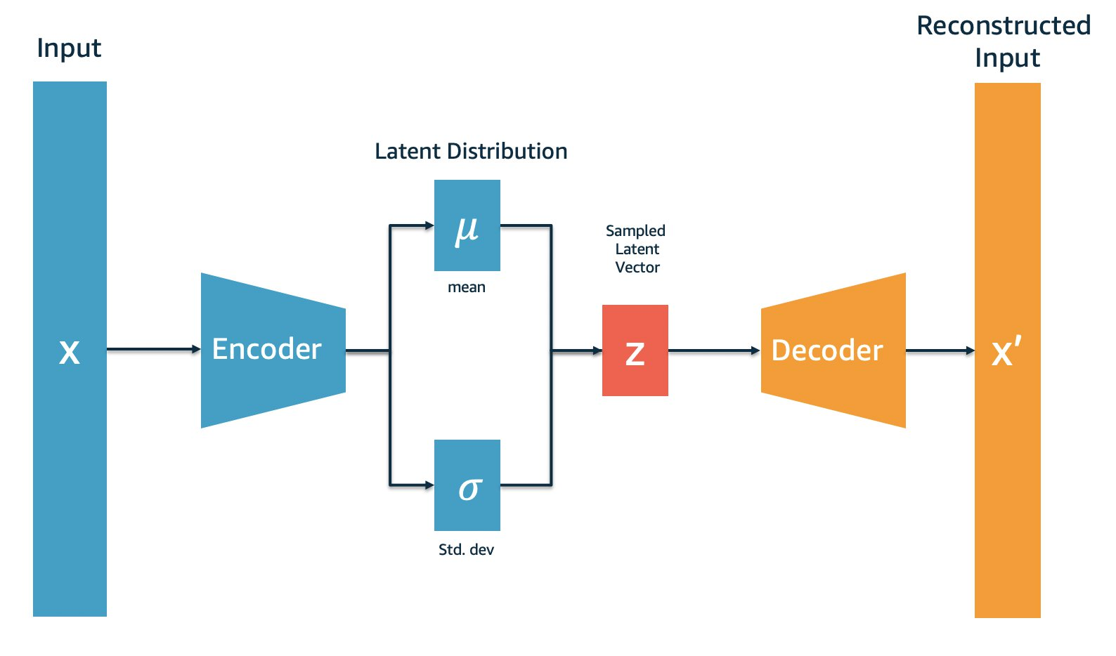
Variational AutoEncoder
Same structure as a normal AutoEncoder
We want stochasticity in our model
Map inputs to a probability distribution over our latent space
Learn the statistics of our latent space

Slide 31
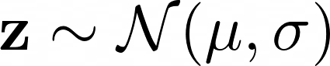
Variational AutoEncoder
Same structure as a normal AutoEncoder
We want stochasticity in our model
Map inputs to a probability distribution over our latent space
Learn the statistics of our latent space

Slide 32
Variational AutoEncoder
Model is stochastic now! We want determinism back!

Slide 33
Variational AutoEncoder
Model is stochastic now! We want determinism back!
Cannot compute gradients through a stochastic layer
Derivative should be non-zero

Slide 34
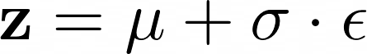
Variational AutoEncoder
Model is stochastic now! We want determinism back!
Cannot compute gradients through a stochastic layer
Derivative should be non-zero
Reparameterization ‘hack’
Backpropagation possible

Slide 35
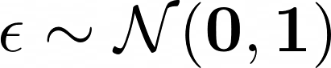
Variational AutoEncoder
Model is stochastic now! We want determinism back!
Cannot compute gradients through a stochastic layer
Derivative should be non-zero
Reparameterization ‘hack’
Backpropagation possible

Slide 36
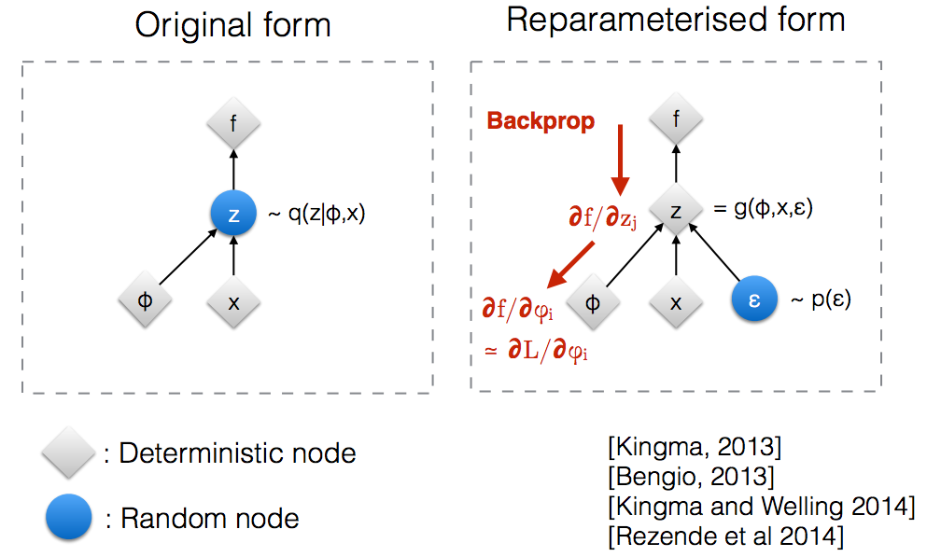
Variational AutoEncoder
Model is stochastic now! We want determinism back!
Cannot compute gradients through a stochastic layer
Derivative should be non-zero
Reparameterization ‘hack’
Backpropagation possible

Slide 37
Variational AutoEncoder
Model is stochastic now! We want determinism back!
Cannot compute gradients through a stochastic layer
Derivative should be non-zero
Reparameterization ‘hack’
Backpropagation possible

Slide 38
Variational AutoEncoder
Reconstruction loss
Not done yet; need to force the network to adhere to to a unit normal distribution
Network will just learn very small standard deviations and learn the mean, similar to a regular autoencoder

Slide 39
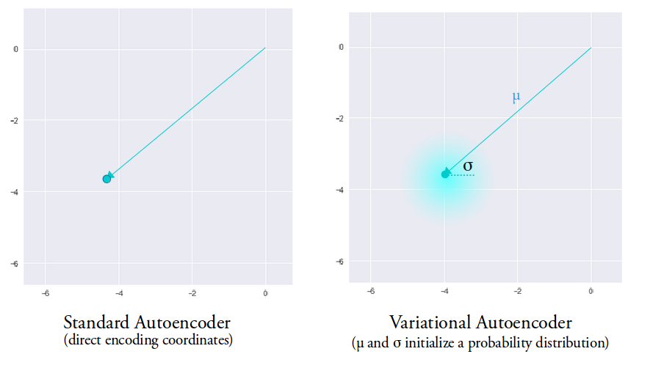
Variational AutoEncoder
Network will just learn very small standard deviations and learn the mean, similar to a regular autoencoder
https://towardsdatascience.com/intuitively-understanding-variational-autoencoders-1bfe67eb5daf

Slide 40
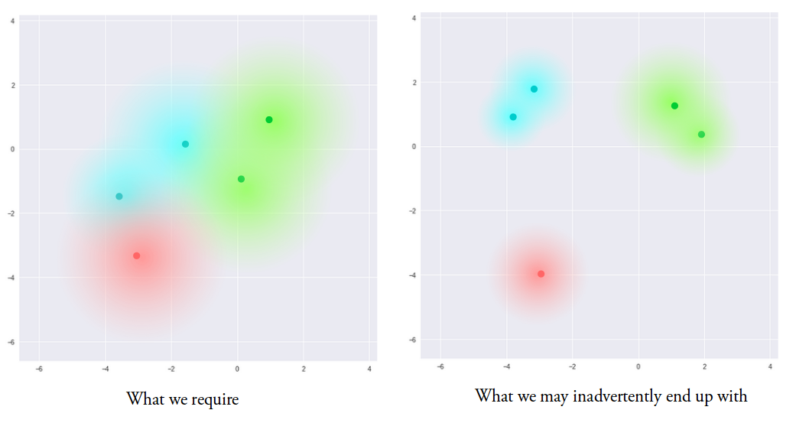
Variational AutoEncoder
Network will just learn very small standard deviations and learn the mean, similar to a regular autoencoder
https://towardsdatascience.com/intuitively-understanding-variational-autoencoders-1bfe67eb5daf

Slide 41
Variational AutoEncoder
We add a regularization term to the reconstruction loss
Not only reconstruct but also stay close to

Slide 42
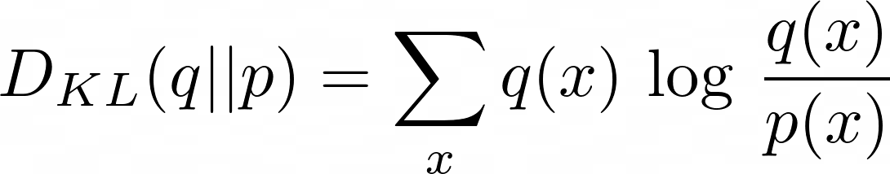
Variational AutoEncoder
We add a regularization term to the reconstruction loss
Not only reconstruct but also stay close to
Use the Kullback-Leibler divergence from information theory
Measures the information content between distributions q and p

Slide 43
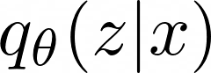
Variational AutoEncoder
We add a regularization term to the reconstruction loss
Not only reconstruct but also stay close to
Use the Kullback-Leibler divergence from information theory
Measures the information content between distributions q and p
We want the (posterior) distribution that we are learning

Slide 44
Variational AutoEncoder
We add a regularization term to the reconstruction loss
Not only reconstruct but also stay close to
Use the Kullback-Leibler divergence from information theory
Measures the information content between distributions q and p
We want the (posterior) distribution that we are learning to be close to a (prior) standard normal distribution

Slide 45
Variational AutoEncoder
We add a regularization term to the reconstruction loss
Not only reconstruct but also stay close to
Use the Kullback-Leibler divergence from information theory
Measures the information content between distributions q and p
We want the (posterior) distribution that we are learning to be close to a (prior) standard normal distribution
Why standard normal though?

Slide 46
Variational AutoEncoder
We add a regularization term to the reconstruction loss
Not only reconstruct but also stay close to
Why standard normal though?
Learn a smooth/continuous distribution
Expand evenly in the latent space
KL divergence with a normal distribution has an easy analytical solution
We can estimate any distribution with a normal distribution

Slide 47
Variational AutoEncoder
We add a regularization term to the reconstruction loss
Not only reconstruct but also stay close to

Slide 48
Variational AutoEncoder
We add a regularization term to the reconstruction loss
Not only reconstruct but also stay close to

Slide 49
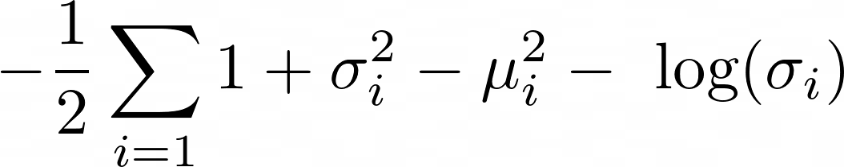
Variational AutoEncoder
We add a regularization term to the reconstruction loss
Not only reconstruct but also stay close to
Likelihood
KLD

Slide 50
Variational AutoEncoder
We add a regularization term to the reconstruction loss
Not only reconstruct but also stay close to

Slide 51
Variational AutoEncoder
We add a regularization term to the reconstruction loss
Not only reconstruct but also stay close to

Slide 52
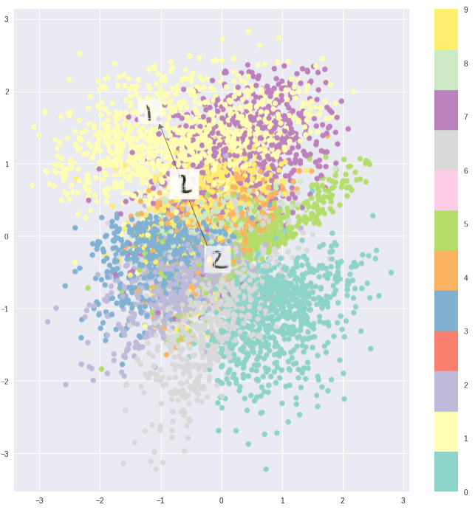
Variational AutoEncoder
We add a regularization term to the reconstruction loss
Not only reconstruct but also stay close to

Slide 53
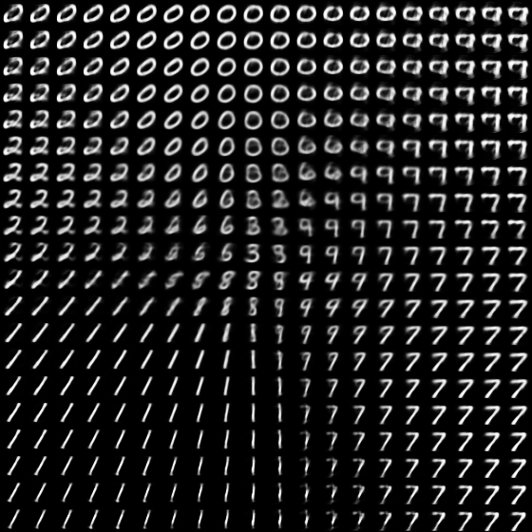
Variational AutoEncoder
We add a regularization term to the reconstruction loss
Not only reconstruct but also stay close to

Slide 54
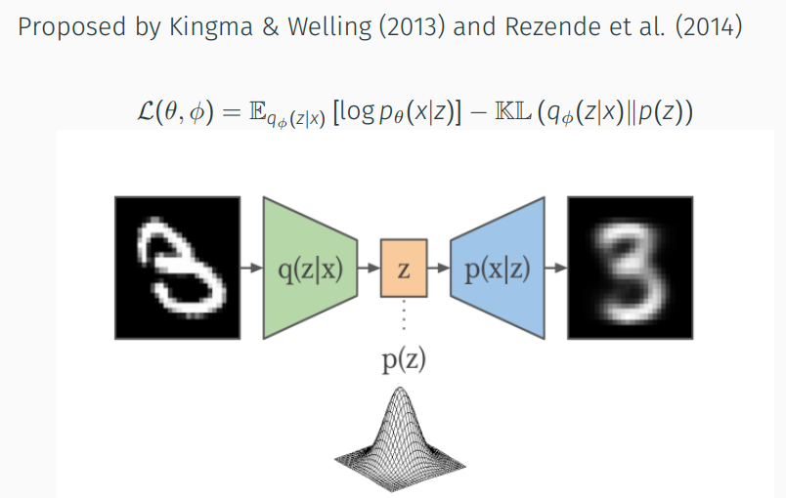
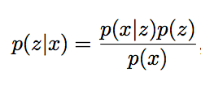
Variational Bayesian AutoEncoder
Evidence lower bound (ELBO)
More on this:
https://arxiv.org/pdf/1906.02691.pdf
https://www.cs.princeton.edu/courses/archive/fall11/cos597C/lectures/variational-inference-i.pdf

Slide 55
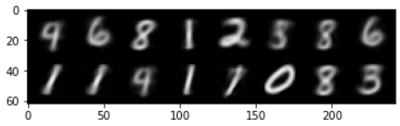
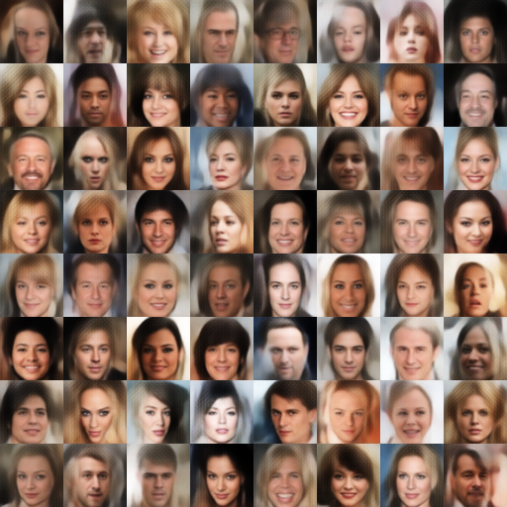
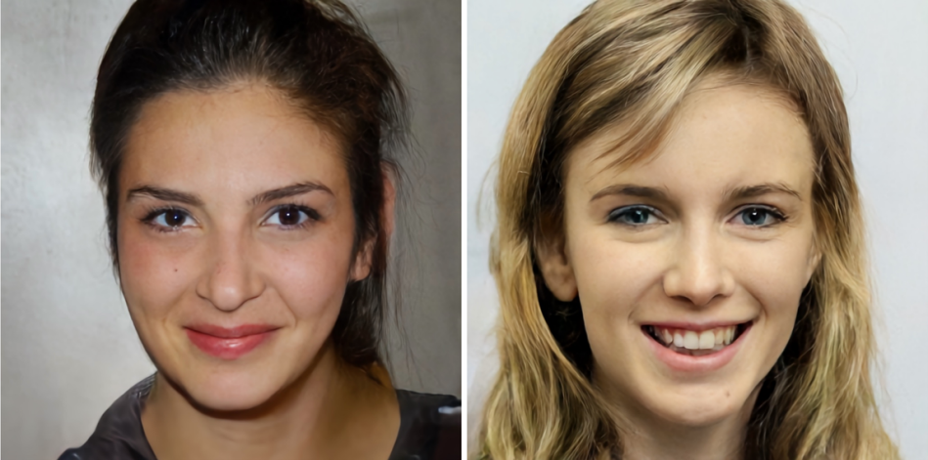
VAE applications

Slide 56
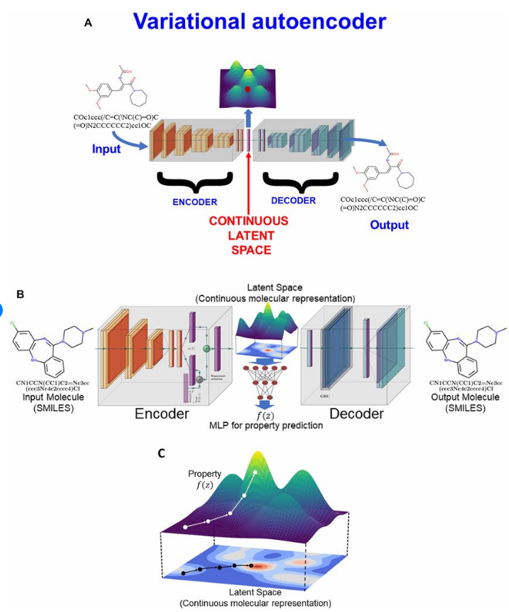
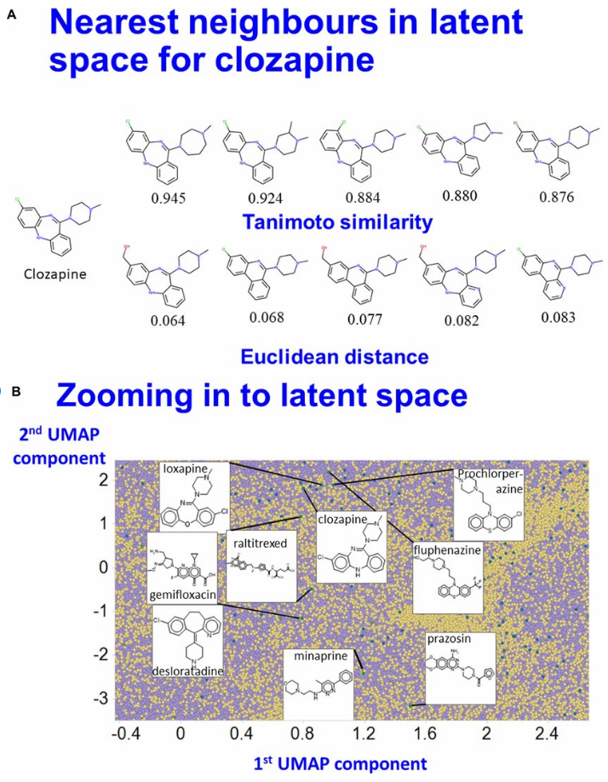
VAE applications
https://www.researchgate.net/figure/Local-properties-of-latent-space-A-Molecules-near-clozapine-A-VAE-was-trained-as-in_fig5_347531998

Slide 57
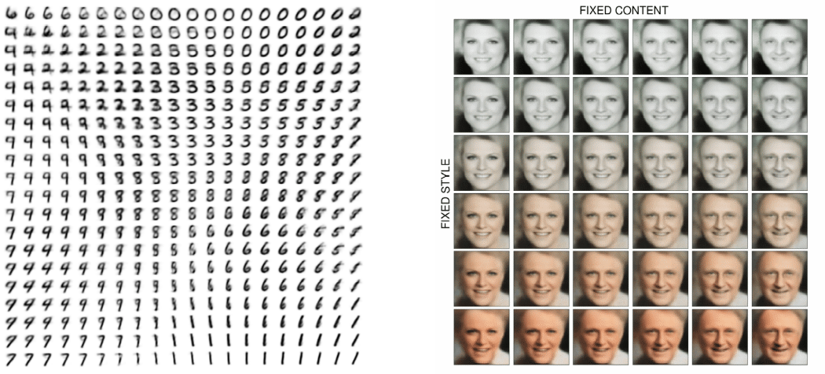
Latent Vector Interpolation

Slide 58
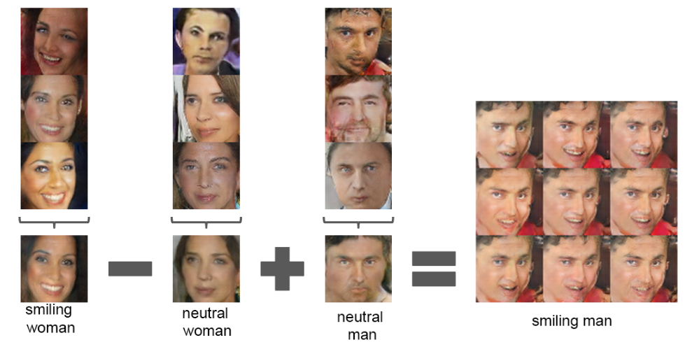
Arithmetic
Latent Space Arithmetic

Slide 59
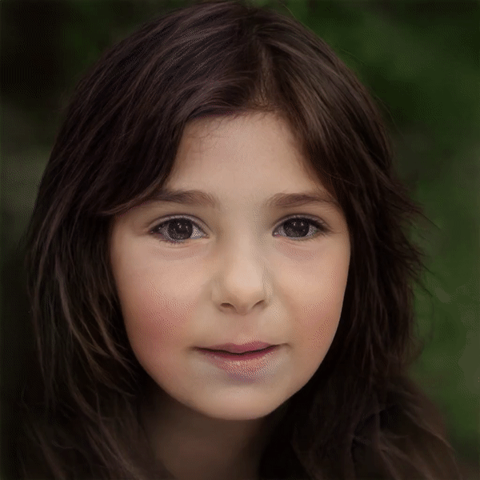
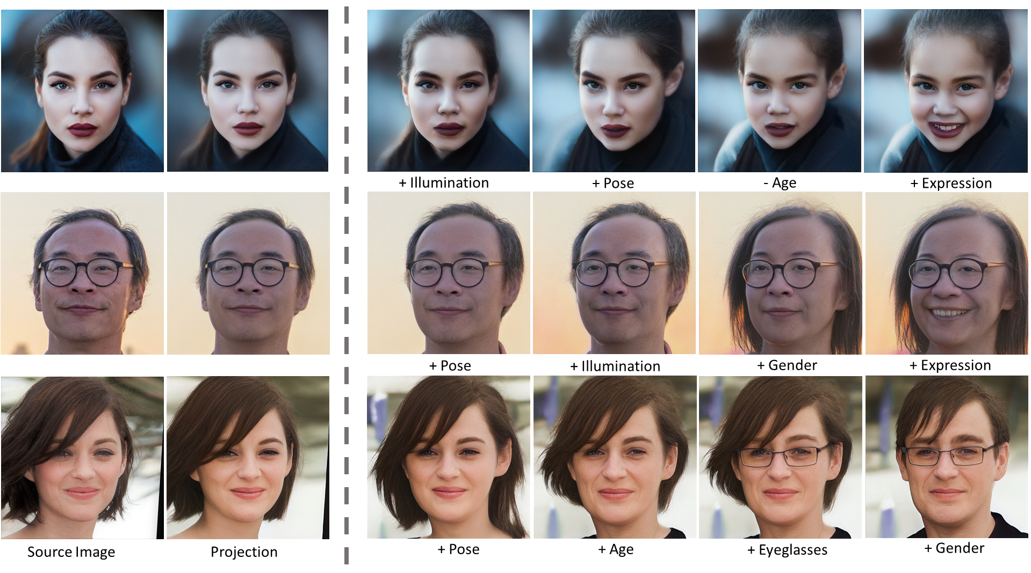
Arithmetic
Latent Space Arithmetic
“StyleFlow: Attribute-conditioned Exploration of StyleGAN-Generated Images using Conditional Continuous Normalizing Flows”

Slide 60
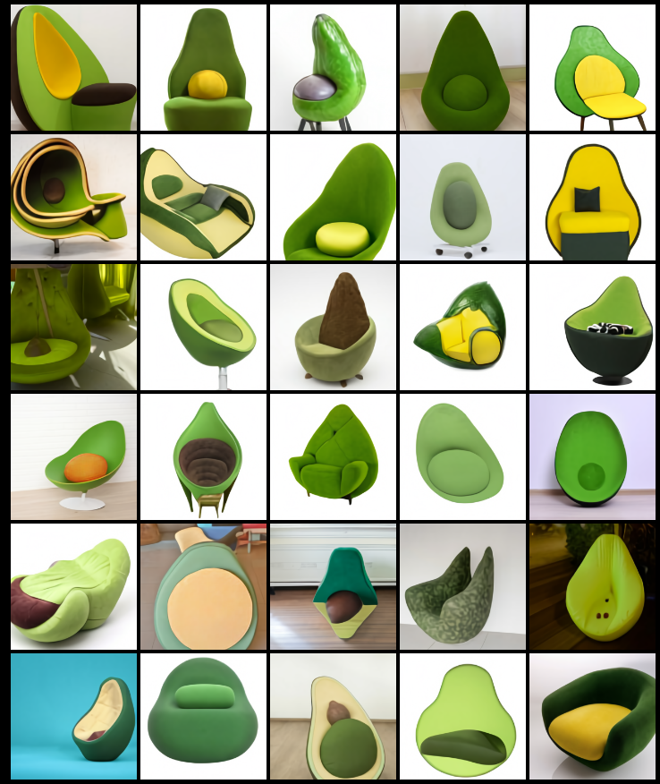
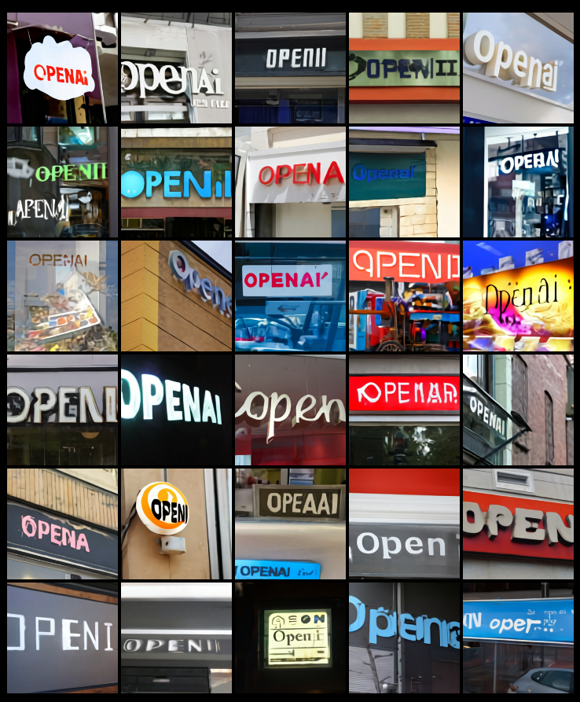
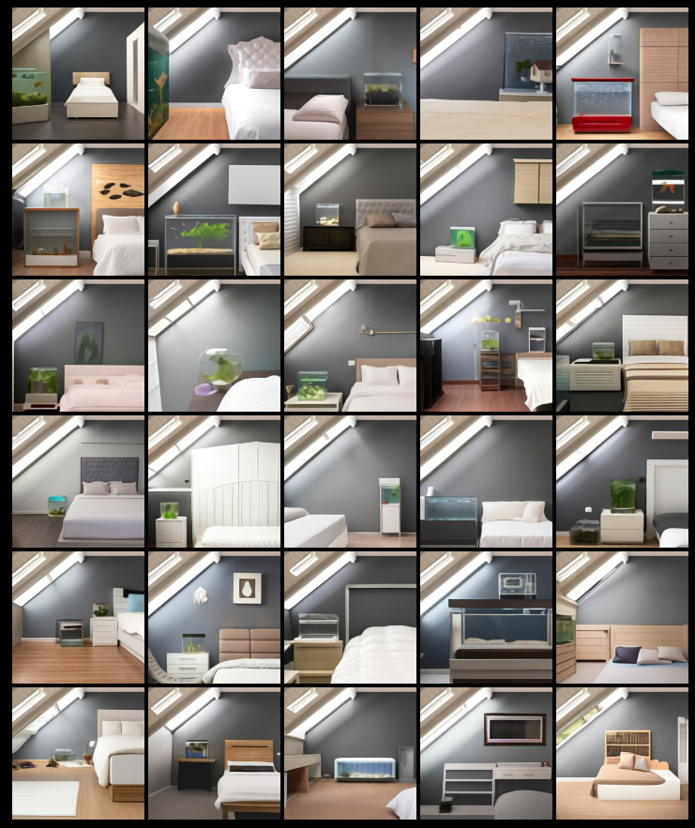
Dall-E
Original Dall-e by OpenAI used a discrete VAE, where the latent space is discrete and not continuous

Slide 61
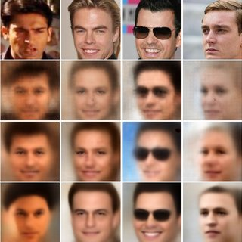
Problems with VAEs
Posterior Collapse: The posterior (encoder) is too weak and the decoder starts ignoring samples from the posterior. The encoder becomes “disconnected” from the mean and standard deviation it needs to learn
Blurry Generations: The assumption of a standard normal distribution makes the generations ‘noisy’.
Using a MSE loss as reconstruction increases the problem

Slide 62
Families of Generative Networks
Variational Autoencoders
Discrete VAEs
GAN (Generative Adversarial Network)
Diffusion Models
Autoregressive Models

Slide 63
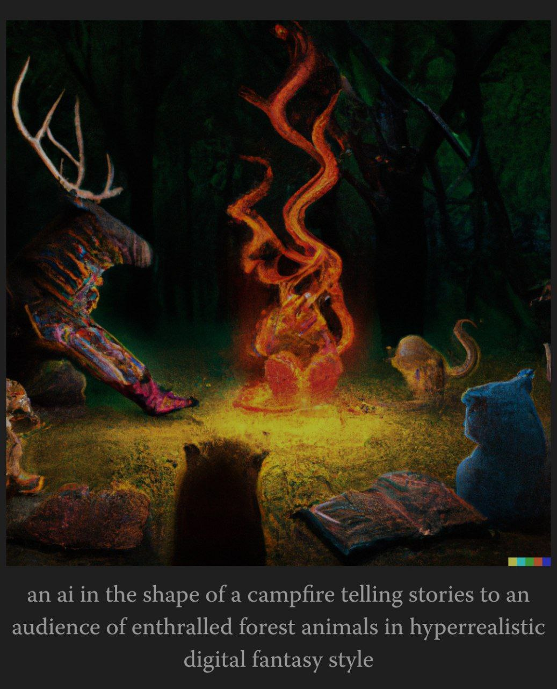
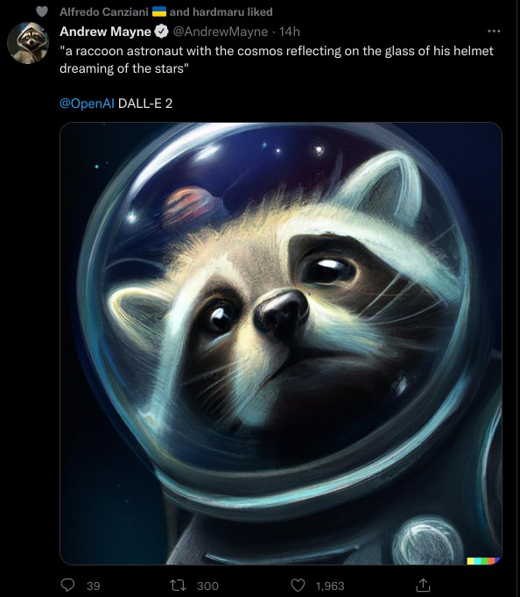
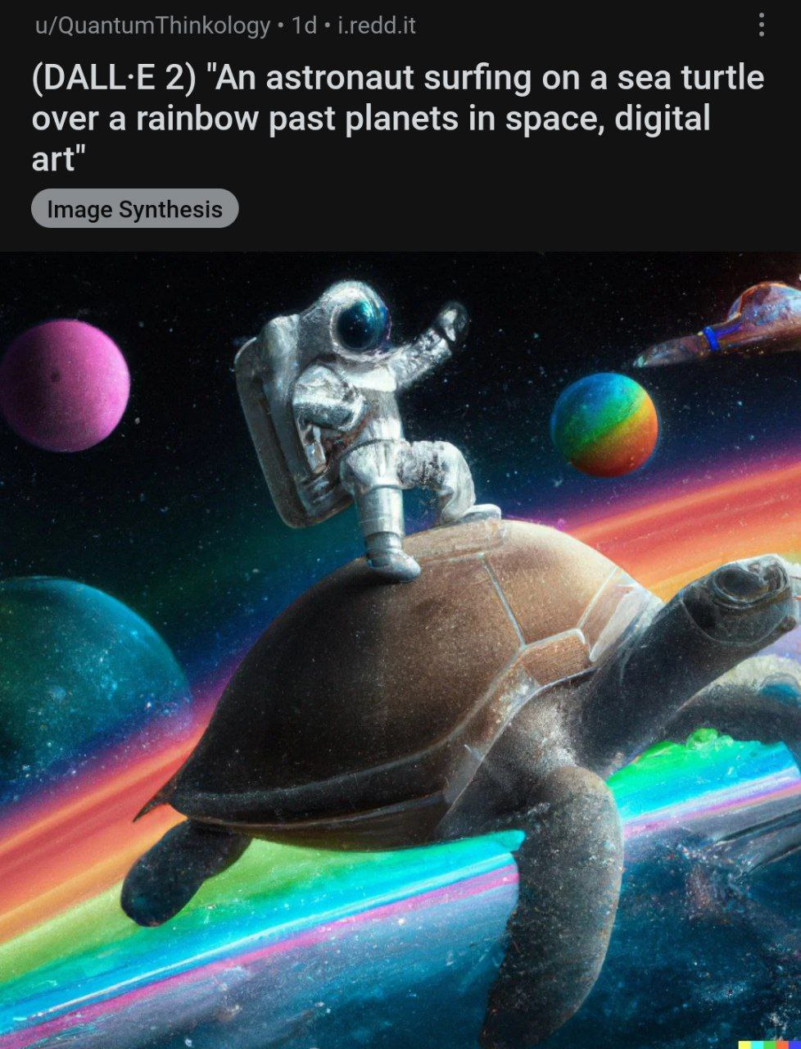
Dall-E 2

Slide 64
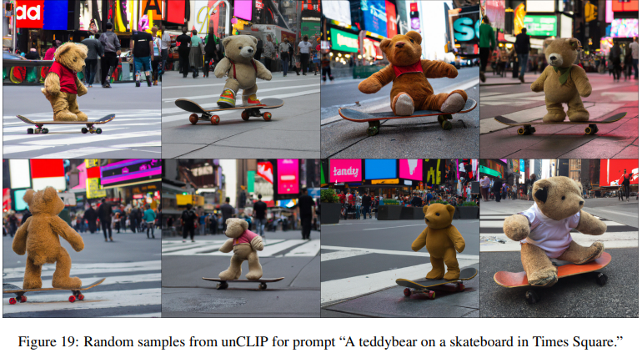
Dall-E 2

Slide 65


Dall-E 2

Slide 66

Quality of GAN-Generated images
https://arxiv.org/pdf/2012.09841.pdf

Slide 67

Quality of GAN-Generated images

Slide 68

Quality of GAN-Generated images

Slide 69

Super Resolution

Slide 70
Change Style: Young to Old
https://yuval-alaluf.github.io/SAM/

